Slide 1



Profiling a Tech Worker
R|R
by Jiji Craynock

Slide 2






America the Melting Pot
The US has long been hailed as the melting pot of the world. Yet, stereotypes are as persistent among Americans as ever.

Slide 3
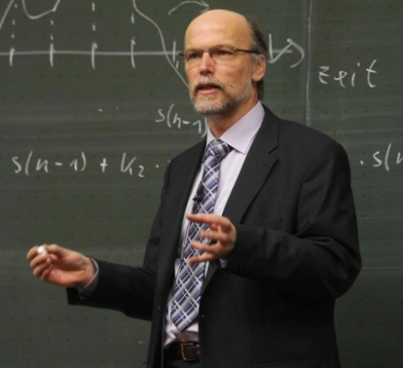





Google As A Reflection of Persistent Biases
When doing an image search for terms like teacher vs. professor, surgeon vs. nurse, and restaurant owner vs. restaurant worker, we are still faced with the same kind of white male leanings that have been the norm for decades

Slide 4

Case Focus
A model that predicts whether or not someone works in the tech industry based on features not usually found on a resume.

Slide 5
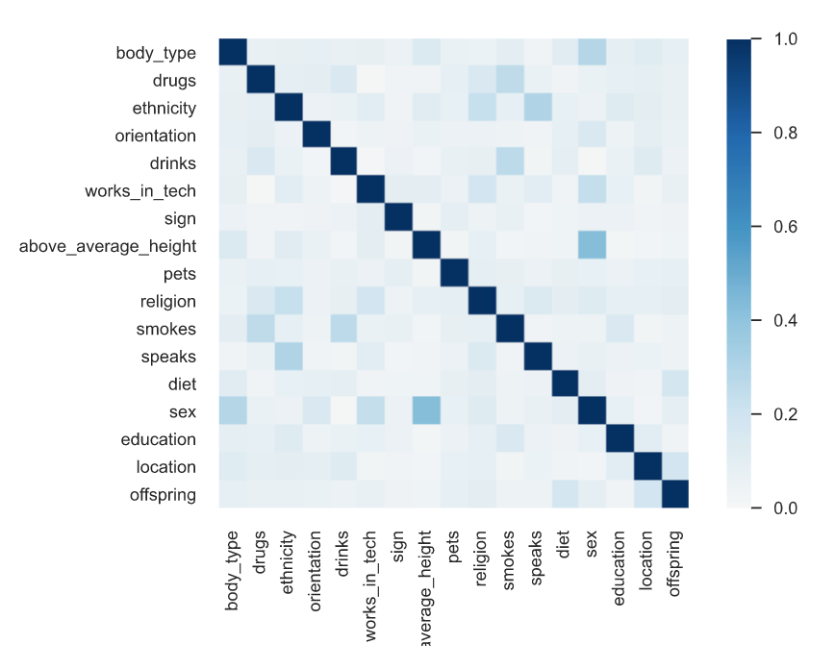

Pre
Processing: Nearly as Complex as People Themselves
In order to run a predictive test, I need to use data that contained job title information as well as other demographic data. OkCupid, a popular dating website collects exactly this type of information.
However, users are not required to fill out the vast majority of questions and have a plethora of ways to answer when they do choose to. This meant that in order to prepare the data each feature needed to be re-engineered for modeling. The result was a whole host of categorical features, none of which at a glance said much about anything.

Slide 6
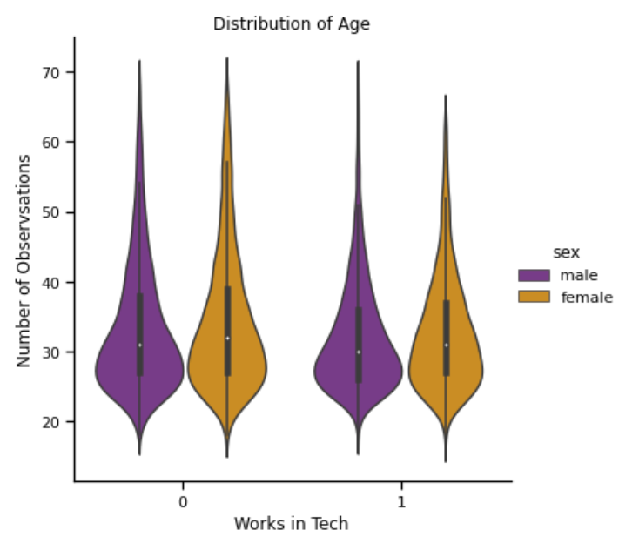
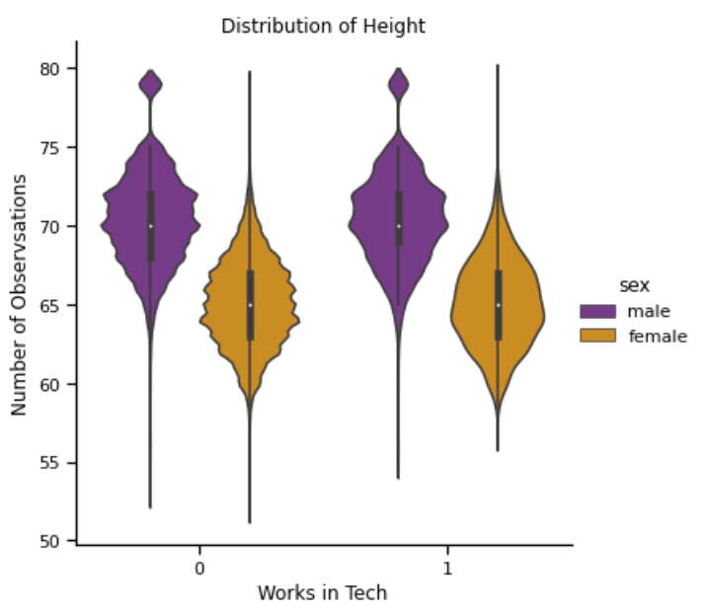
Exploratory Data Analysis
Once I began to visualize the data, patterns started to emerge, between those who work in tech and the general population. Here we can see that those who were in tech tend to a bit younger with a shorter range of ages when it comes to women. We see a similar pattern when it comes to height, with those that work in tech seeming to tend to be a bit taller. Notably, this is likely affected by the overall class sizes.

Slide 7

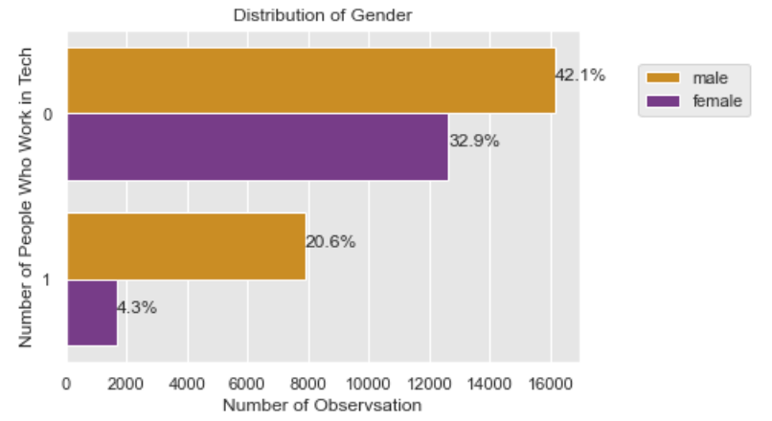

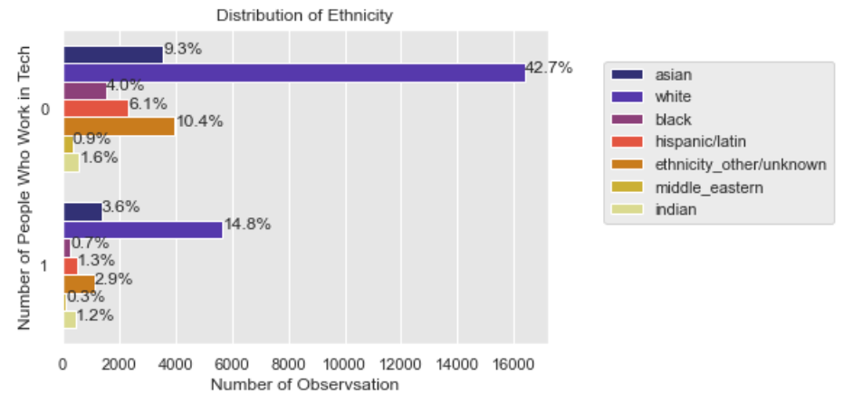
Distribution of Gender
Distribution of Ethnicity

Slide 8
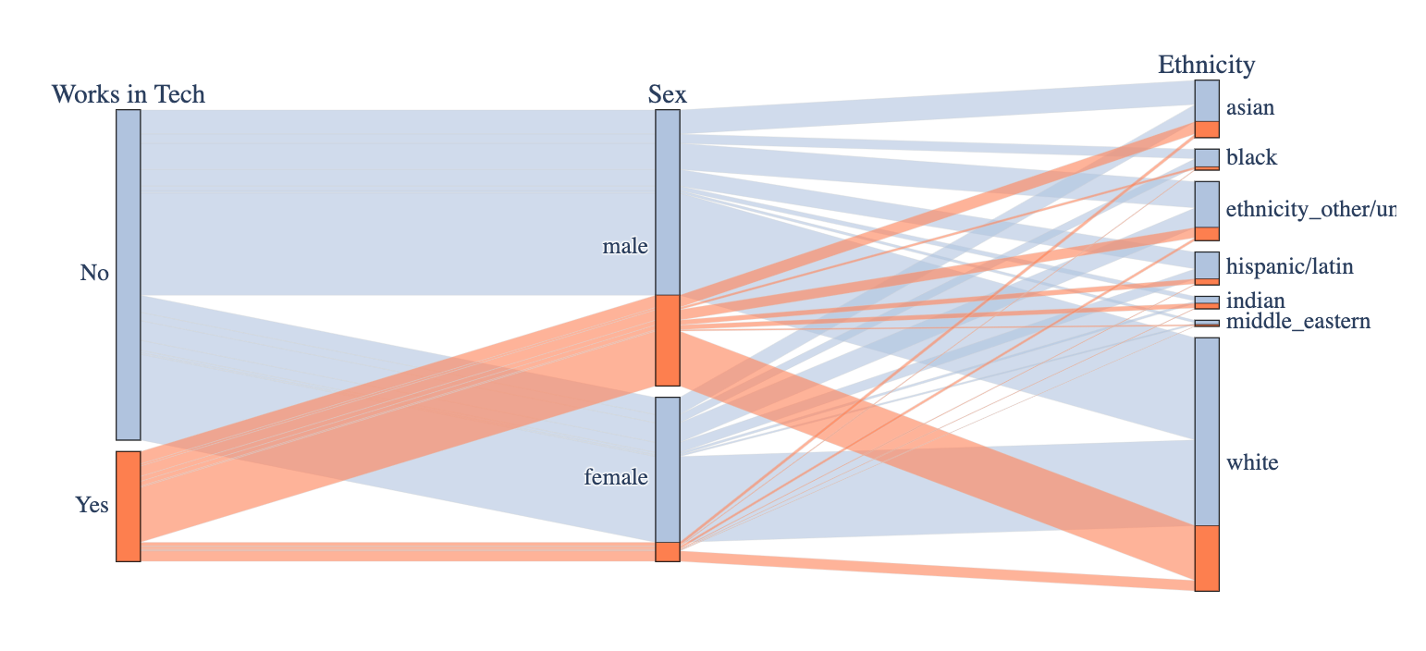
Sex and Ethnicity Distribution
As previously mentioned, there is a class imbalance in my data but even so, there is an emerging pattern when looking at the charts proportionally. Here we can clearly see that although the non-tech class is bigger the male-to-female ratio is very different. as is the ethnic distribution.

Slide 9
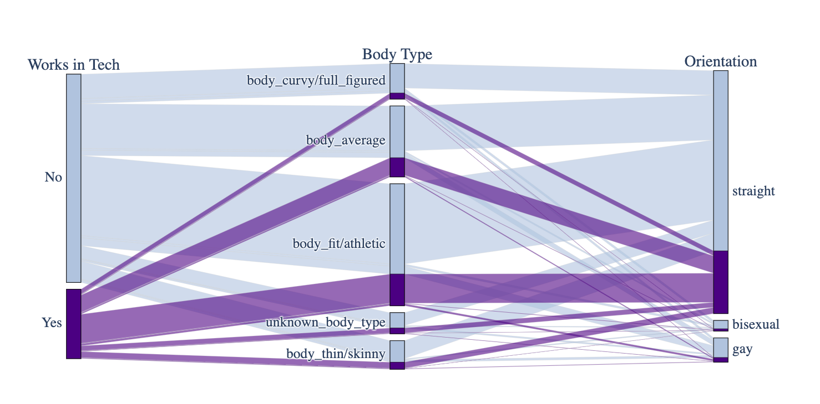
Body Type and Sexual Orientation Distribution
Between body type and orientation, the pattern is decidedly less pronounced but still marked between the two classes. Though both of those features also had a class imbalance which may be skewing the graph a bit.

Slide 10
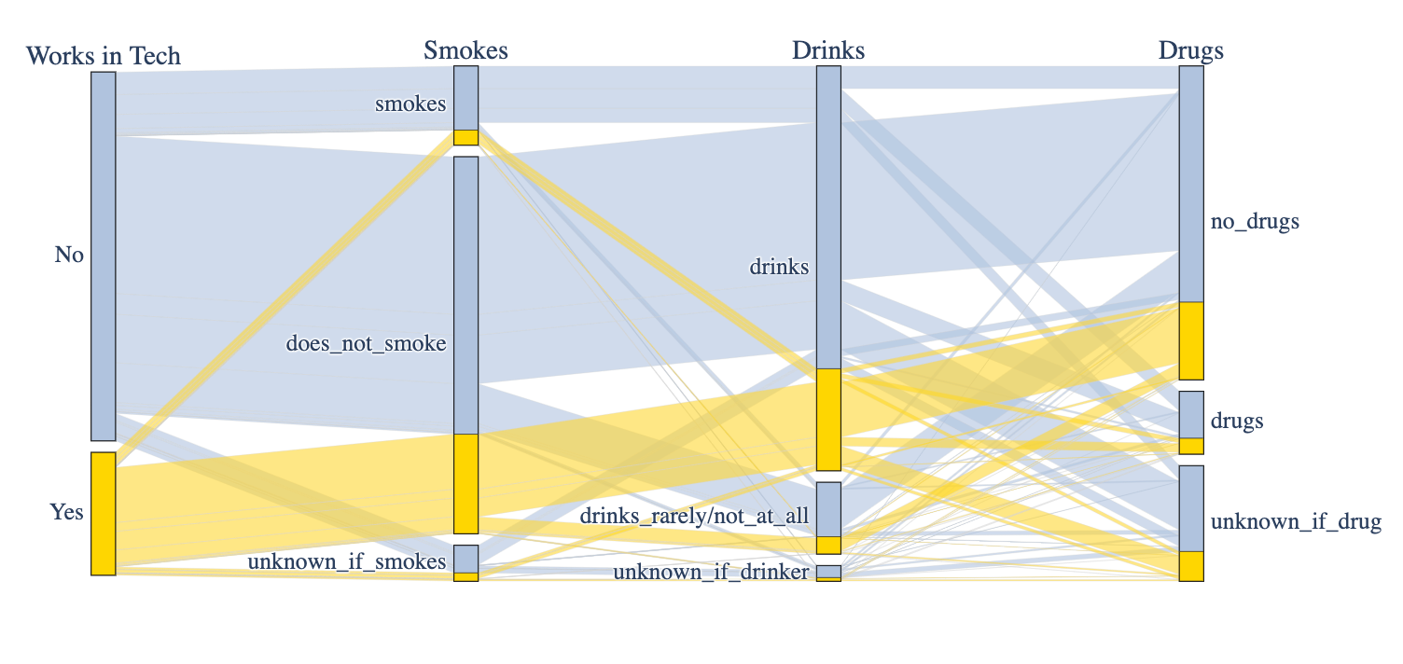
Drugs, Drinking, & Smoking Distribution
In this chart, we can see that there isn't much difference between the two classes proportionally and both groups have a good amount of variation when it comes to drugs.

Slide 11
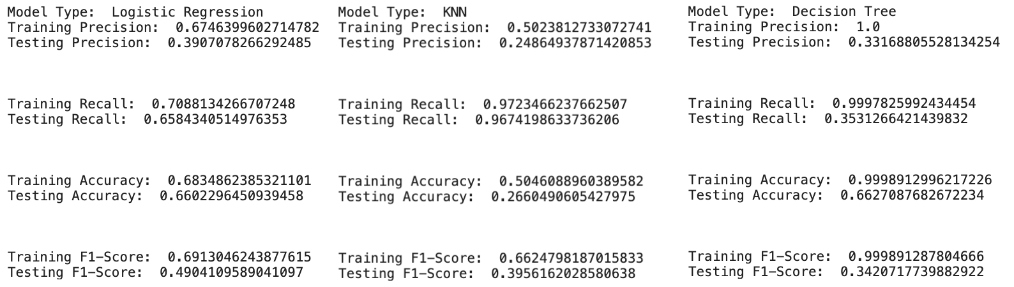
Model Test
Models Tested:
Logistic Regression
KNN
Decision Tree
I tested a total of seven classifiers on this model. It quickly became apparent that my data was even noisier than I had initially thought as a result every model was overfit.

Slide 12
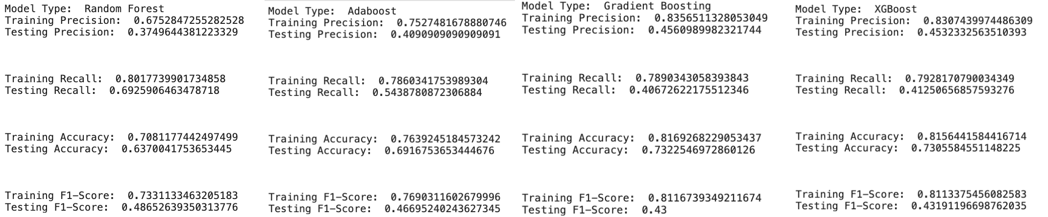
Ensemble Model Test
The ensemble methods in some cases did perform better than the solo methods however they were all incredibly unstable. For this reason I chose not to use any of them for my final model.
Models Tested:
Logistic Regression
KNN
Decision Tree

Slide 13
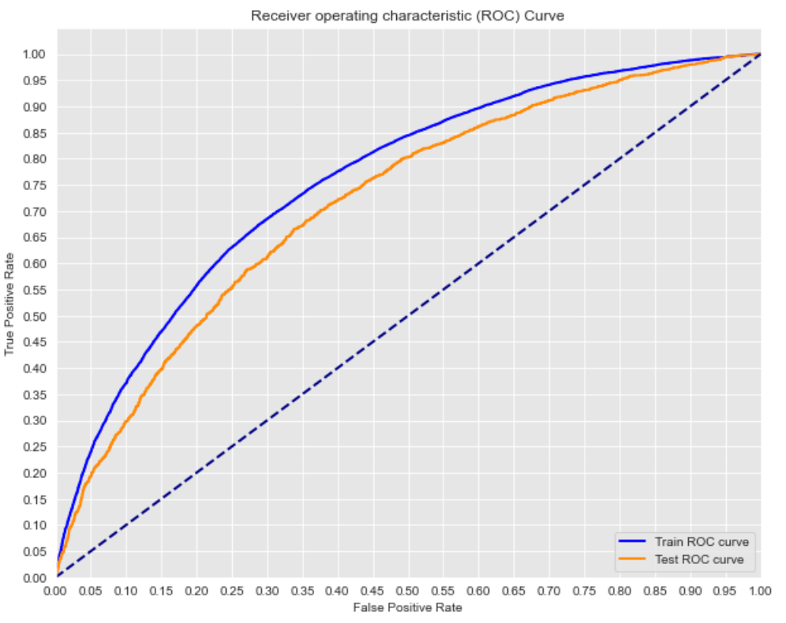
The Logical Choice was Logistic Regression .... Sort Of
Logistic Regression was ultimately the model that performed the best on my data set, however, even after extensive feature selections and tuning it did not improve much from the baseline. This indicates to me that either this class can't be reasonably predicted from these features or different work needs to be done on the underlying data.
R|R

Slide 14
Conclusion & Next Steps
This project took many twists and terms and ultimately my model did not perform as well as I may have liked but I do think there are reasons for that beyond the model. The fact that the model had trouble predicting is a good thing. It means my target is varied enough to not be easily distinguished which leads me to think that the population of people who work in tech, is in fact, quite diverse. Though further testing would be needed to prove this theory.
Next steps: in order to take this project to the next level, I believe there are a number of things that could be done. Among the first steps would be to re-integrate many of the attitudes and more specific categories that were simplified early on in this project. Next, I think using data from a non-dating site would perhaps also give a clearer picture since it is hard to say if this sample is truly representative of the whole give where the data was sourced from.
R|R

Slide 15
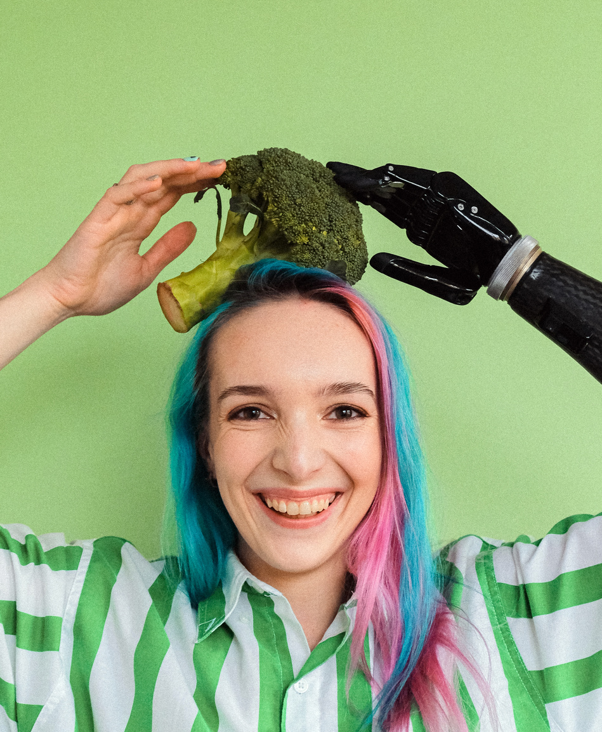
Thank You.
Questions?
Email: dataonatangent@gmail.com
Twitter: @dataonatangent
Medium: dataontangent.medium.com
R|R

